Slide 1

6th Grade Math
Unit 5, Lesson 7 Solving Problems Involving Rectangles on the Coordinate Plane Volume 1, pg. 241

Slide 2


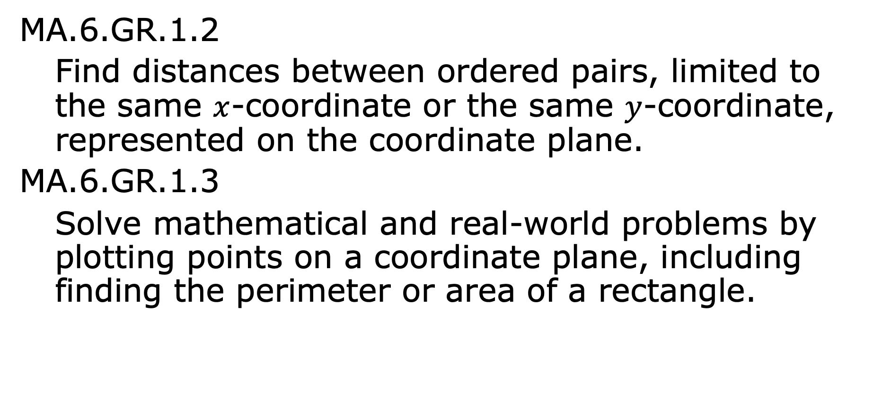
Benchmarks
MA.6.GR.1.2
Find distances between ordered pairs, limited to the same $x$-coordinate or the same $y$-coordinate, represented on the coordinate plane.
MA.6.GR.1.3
Solve mathematical and real-world problems by plotting points on a coordinate plane, including finding the perimeter or area of a rectangle.
volume 1, pg. 241

Slide 3
Integrated Mathematical Thinking and Reasoning Standards
MA.K12.MTR.1.1 Actively participate in effortful learning both individually and collectively.
MA.K12.MTR.4.1 Engage in discussions that reflect on the mathematical thinking of self and others.
MA.K12.MTR.5.1 Use patterns and structure to help understand and connect mathematical concepts.
MA.K12.MTR.7.1 Apply mathematics to real-world contexts.
volume 1, pg. 241

Slide 4

Learning Targets
I can find distances between ordered pairs.
I can find the area of a rectangle on a coordinate plane.
I can find the fourth vertex of a rectangle on a coordinate plane.
volume 1, pg. 241

Slide 5

Warm-Up
volume 1, pg. 241

Slide 6

5.7.1 Warm-Up: True Statement
Place a digit in each blue box to make the statement true. Use only digits 1 to 9, at most one time each.
volume 1, pg. 241

Slide 7

Collaboration
volume 1, pg. 242

Slide 8

5.7.2 Collaboration: Area of Rectangles
Work with your partner to explain how to find the area of a rectangle.
volume 1, pg. 242

Slide 9
A rectangle with coordinate $(3, 0)$, $(3, −5)$, $\left(−4, 0\right),$ and $(−4,−5)$ is shown. The scale of the grid is in centimeters (cm).
Work with your partner to answer the following questions.
Determine the length and the width of the rectangle. Include units.
What is the area of the rectangle? Include units.
volume 1, pg. 242

Slide 10

Guided Practice
volume 1, pg. 242

Slide 11

5.7.3 Guided Practice: Finding the Area of Rectangles on the Coordinate Plane
Henry wants to install new carpet in his living room. A drawing of his living room, with measurements in feet, is shown.
What is the area of the living room?
volume 1, pg. 242

Slide 12
A rectangle is shown.
What is the area of the rectangle?
volume 1, pg. 243

Slide 13
Collaboration
volume 1, pg. 243

Slide 14
5.7.4 Collaboration: Finding the Fourth Vertex
With your partner, list every attribute you know about rectangles.
With your partner, find another pair of partners. Share what you wrote about rectangles. Add any new attributes the other group found that you didn’t.
Rectangles
volume 1, pg. 243

Slide 15
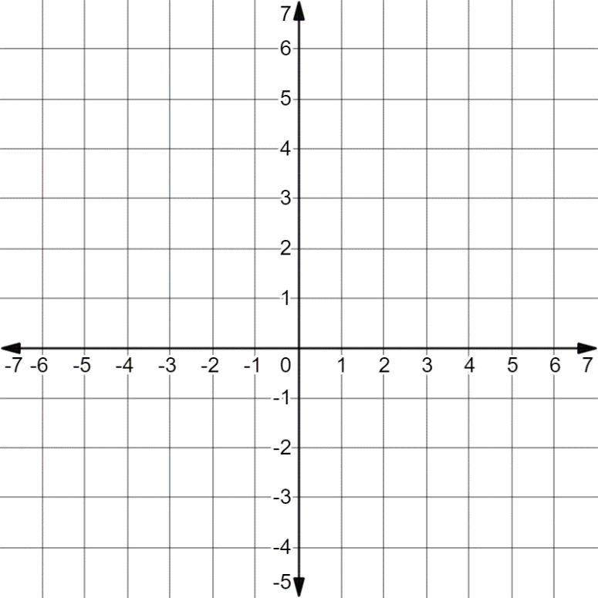
On the coordinate grid, draw a rectangle whose sides lie on the gridlines. Label the ordered pair of each vertex.
volume 1, pg. 244

Slide 16
Discuss with your partner how to determine where to place the vertices of your rectangle. Write a summary of your discussion.
Based on the rectangle drawn in the previous questions, add any attributes about rectangles to your list.
volume 1, pg. 244

Slide 17
Guided Practice
volume 1, pg. 244

Slide 18
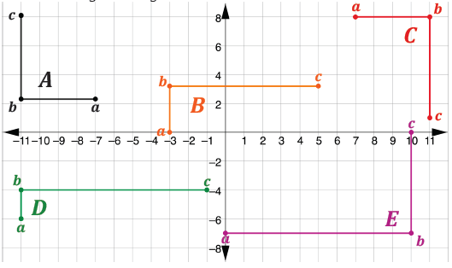
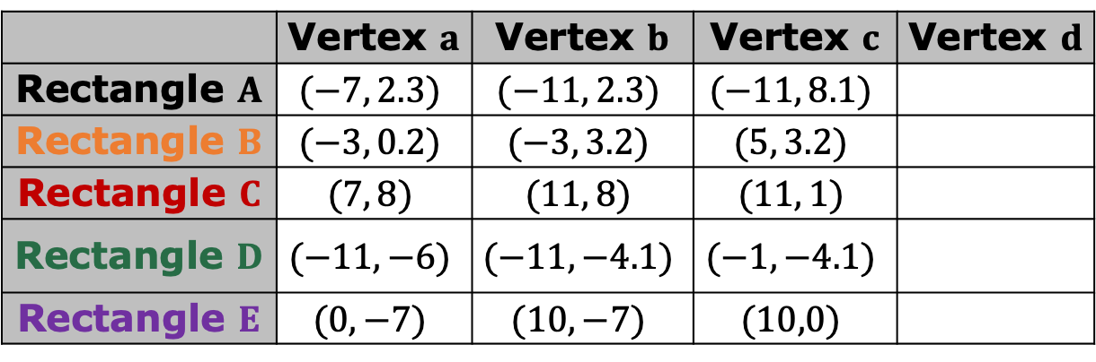
5.7.5 Guided Practice: Finding the Fourth Vertex
Using the coordinate plane, find the fourth vertex of the following rectangles.
 | Vertex $a$ | Vertex $b$ | Vertex $c$ | Vertex $d$
Rectangle $A$ | $$(−7, 2.3)$$ | $$(−11, 2.3)$$ | $$(−11, 8.1)$$
Rectangle $B$ | $$(−3, 0.2)$$ | $$(−3, 3.2)$$ | $$(5, 3.2)$$
Rectangle $C$ | $$(7, 8)$$ | $$(11, 8)$$ | $$(11, 1)$$
Rectangle $D$ | $$(−11, −6)$$ | $$(−11, −4.1)$$ | $$(−1, −4.1)$$
Rectangle $E$ | $$(0, −7)$$ | $$(10, −7)$$ | $$(10,0)$$
volume 1, pg. 244

Slide 19

What is the area of Rectangle A, in square units?
 | Vertex $a$ | Vertex $b$ | Vertex $c$ | Vertex $d$
Rectangle $A$ | $$(−7, 2.3)$$ | $$(−11, 2.3)$$ | $$(−11, 8.1)$$
Rectangle $B$ | $$(−3, 0.2)$$ | $$(−3, 3.2)$$ | $$(5, 3.2)$$
Rectangle $C$ | $$(7, 8)$$ | $$(11, 8)$$ | $$(11, 1)$$
Rectangle $D$ | $$(−11, −6)$$ | $$(−11, −4.1)$$ | $$(−1, −4.1)$$
Rectangle $E$ | $$(0, −7)$$ | $$(10, −7)$$ | $$(10,0)$$
volume 1, pg. 244

Slide 20

Your Turn
volume 1, pg. 245

Slide 21
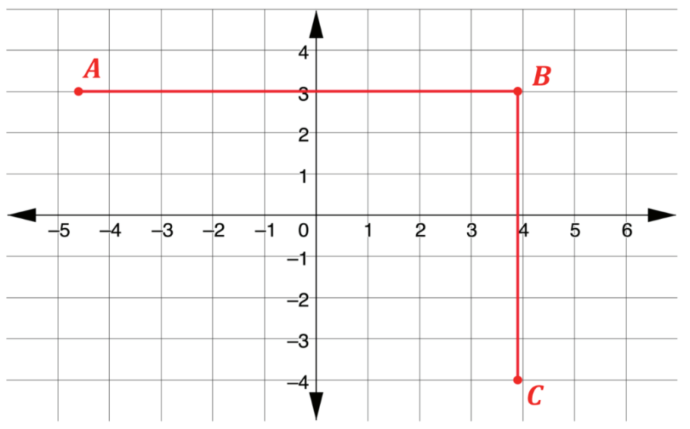
5.7.6 Your Turn!
Three vertices of a rectangle are at points $A (−4\frac{3}{5}, 3)$, $B (3\frac{9}{10}, 3)$, and $C (3\frac{9}{10}, −4)$. Each gridline represents 1 centimeter.
What are the coordinates of the fourth vertex?
What is the area of the rectangle?
volume 1, pg. 245

Slide 22
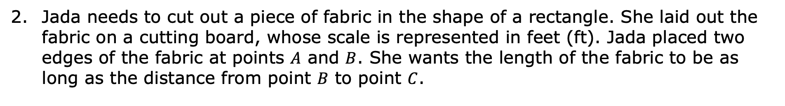
Jada needs to cut out a piece of fabric in the shape of a rectangle. She laid out the fabric on a cutting board, whose scale is represented in feet (ft). Jada placed two edges of the fabric at points $A$ and $B$. She wants the length of the fabric to be as long as the distance from point $B$ to point $C$.
Determine the coordinates of the fourth corner of the fabric.
Find the area of the piece of fabric.
volume 1, pg. 245

Slide 23

Wrap-Up
volume 1, pg. 246

Slide 24
5.7.7 Wrap-Up: Reflection
Complete the following statements.
Today, I am still unsure about …
To fill this gap, I intend to …
volume 1, pg. 246

